Slide 1
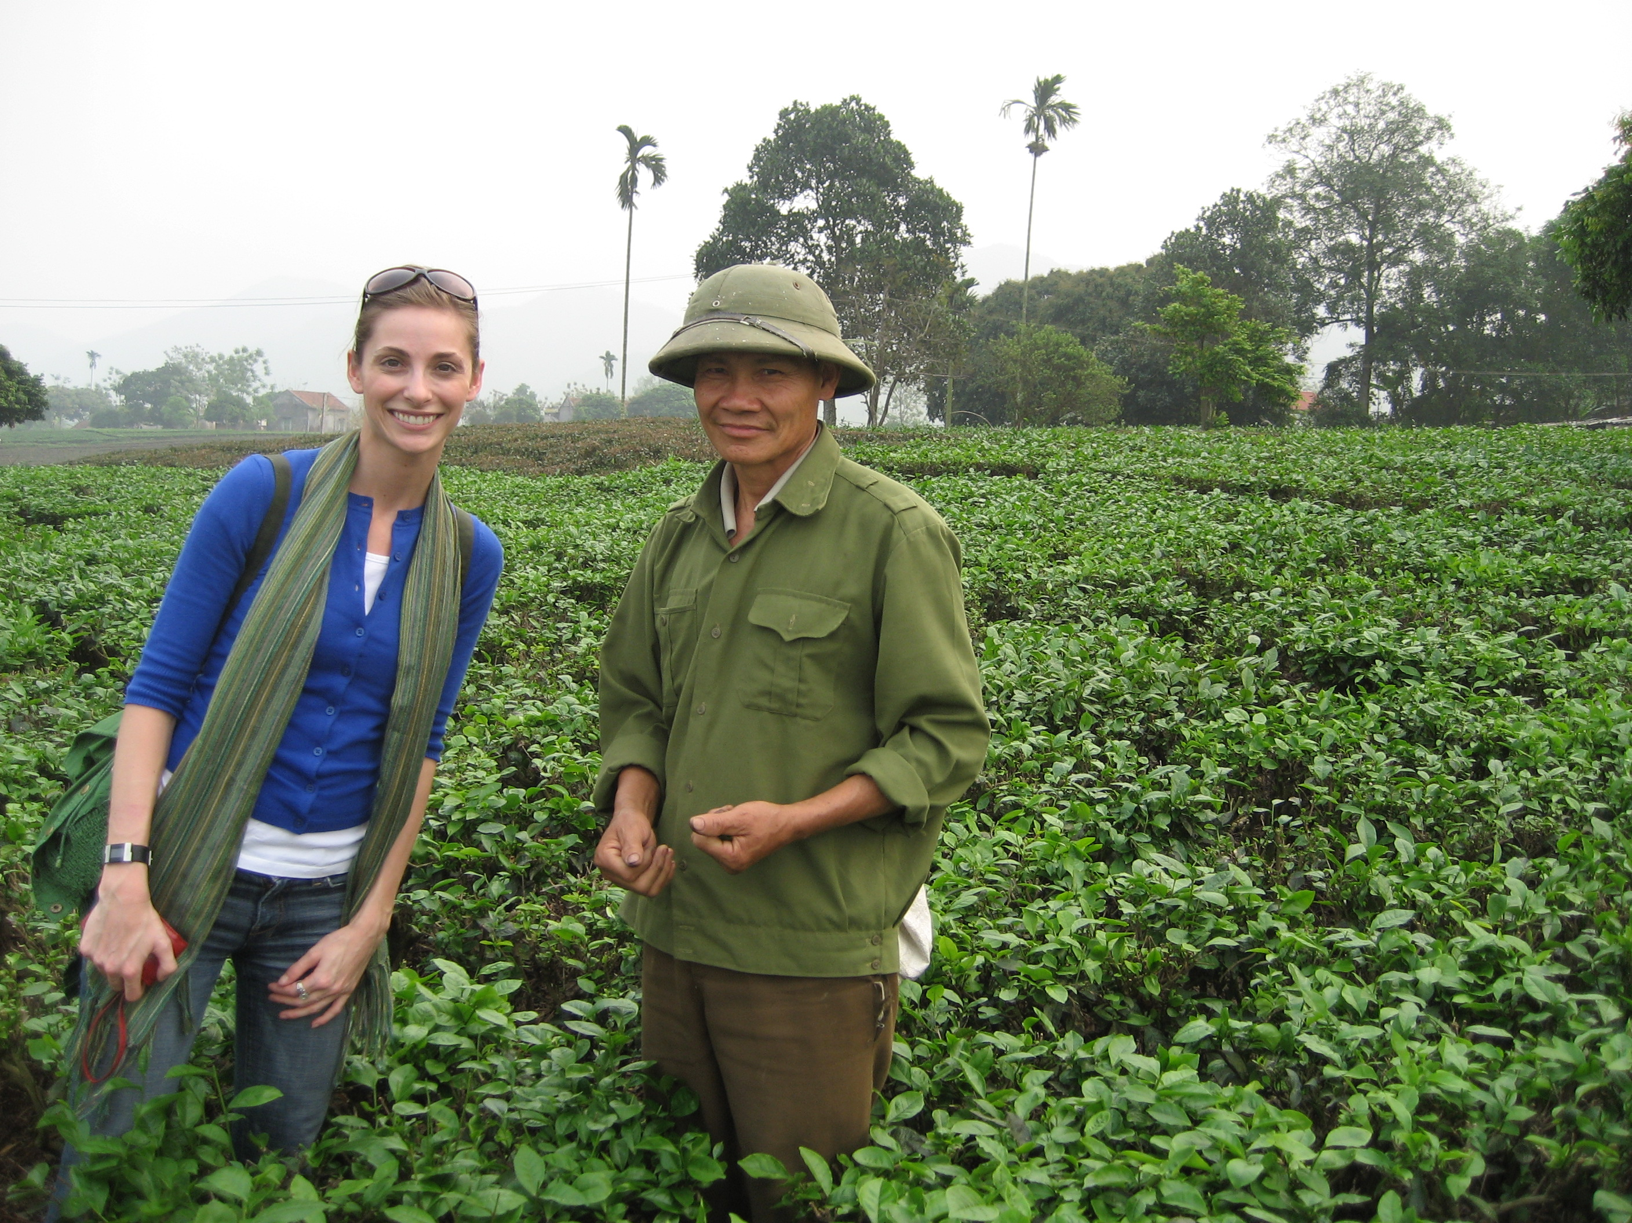
A line of tea products that are designed specifically and uniquely for the target consumer at each retail account where distribution is secured.
The Opportunity
  Tea Industry Trends
    Almost a $15 Billion Industry in US*
    Extremely high margin
    Second most consumed beverage worldwide, but in the US sits behind coffee, beer, and carbonated beverages
    US tea market is growing
      CAGR for the period from 2003 to 2007 was 12.7%,*
      Projected 15% CAGR between 2007 to 2012**
  Consumer Unmet Needs
    Healthy beverage that enhances well-being; alternative to coffee, soda and alcohol (health benefits at forefront)
    Simple, everyday worldly experiences (region/country at forefront)
    Philanthropic and fair trade practices from the products they buy
    Seasonal flavors
  Retailer Unmet Needs
    Products created uniquely for their shoppers
    High profit margin
    Product/shelving principles that will grow the entire category
    Private label/captive brands that can only be found at their store
    85% of all product decisions are made at the shelf***
Business Model
  Manufacturer to retailer model with initial focus on health-oriented retailers like Whole Foods, Trader Joes, Walgreens, etc.
    *from a research paper Tea and Ready-to-drink ("RTD")
    **Tea and RTD Tea in US, 2007, pg 25
    ***P&G consumer research
Notes:
At $15B industry and extremely high margins, the tea industry is an attractive one.
American consumers have a growing interest in tea and a desired drinking experience that our team will capitalize on. Consumers are seeking a healthy, uplifting, and easy to make beverage alternative to coffee, soda, and alcohol. (If we don’t put the health concept at the forefront, we could go with one that more heavily portrays the global nature of tea – highlighting its region, country, etc. (like wine). Something like this: Providing consumers a way to transform their day into a global adventure with just one sip. We’ll need to work on this concept, potentially testing which idea is biggest.)
To deliver this product to the marketplace, our team will break the rules:
The “one brand fits all model” in the CPG retail world is becoming obsolete. Retailers want customized solutions build uniquely around their particular shopper target, and with 85% of shopper decisions being made at the shelf, they have the power to demand it. This trend is witnessed by the incredible focus on private label and captive brand offerings by retailers. Our tea product will act as a captive brand for each of our retail partners…keeping the product generally the same (perhaps differentiating by flavor), but the packaging and the messaging will be uniquely customized and co-created with each retail partner. While other CPG companies like Unilever and P&G hold strong to their “one brand, one product” for everyone, our business will break the rules.

